Slide 1

B.VISHNU
Final Project
KVCET
3rd Year B.E-CSE
NM ID:au421221104057
Email id:bvishnubalaji20@gmail.com
3/21/2024 Annual Review

Slide 2

PROJECT TITTLE:
Face Generation Using Generative adversarial networks
3/21/2024 Annual Review

Slide 3


AGENDA
Problem Statement
Project Overview
End Users
Solution and Value Proposition
The Wow in Your Solution
Modelling
Results
3/21/2024 Annual Review

Slide 4

PROBLEM STATEMENT:
Face generation is a challenging task due to the high complexity and variability of human faces. There are many factors that contribute to the appearance of a face, including age, gender, ethnicity, expression, and pose. Additionally, faces can be occluded by hair, glasses, or other objects. This makes it difficult to generate realistic and accurate faces.
One of the main challenges in face generation is the lack of training data. There are a limited number of publicly available datasets of faces, and many of these datasets are biased towards certain demographics. This can lead to generated faces that are not representative of the general population.
Despite these challenges, there has been significant progress in face generation in recent years. Generative adversarial networks (GANs) have been particularly successful in generating realistic and accurate faces. GANs are a type of machine learning algorithm that can learn to generate data that is indistinguishable from real data.
3/21/2024 Annual Review

Slide 5

PROJECT OVERVIEW:
The technology behind these kinds of AI is called a GAN, or “Generative Adversarial Network”. A GAN takes a different approach to learning than other types of neural networks(NN). GANs algorithmic architectures that use two neural networks called a Generator and a Discriminator, which “compete” against one another to create the desired result. The Generator’s job is to create realistic looking fake images, while the Discriminator’s job is to distinguish between real images and fake images. If both are functioning at high levels, the result is images that are seemingly identical real-life photos.
3/21/2024 Annual Review

Slide 6

WHO ARE THE END USERS?
Identify potential users:
Graphic designers and artists
Game developers
AI researchers
Facial recognition system developers
3/21/2024 Annual Review

Slide 7

YOUR SOLUTION AND ITS VALUE PROPOSITION
Present your solution, which utilizes advanced GAN architecture for realistic face generation.
Highlight the value proposition:
High fidelity: Producing lifelike faces.
Diversity: Generating faces with various attributes and expressions.
Efficiency: Fast and scalable model training and inference.
Customization: Ability to control and manipulate facial features.
3/21/2024 Annual Review

Slide 8

THE WOW IN YOUR SOLUTION
Showcase the standout features of your solution, such as:
Realism: Creating faces indistinguishable from real ones.
Versatility: Generating faces across different demographics and expressions.
Interactivity: Providing users with intuitive controls for customization.
3/21/2024 Annual Review

Slide 9

MODELLING
Describe the architecture used, such as StyleGAN2.
Explain the training data, including its diversity and sources.
Discuss the training procedure, focusing on progressive training techniques.
Mention evaluation metrics used to assess the quality of generated faces.
3/21/2024 Annual Review

Slide 10
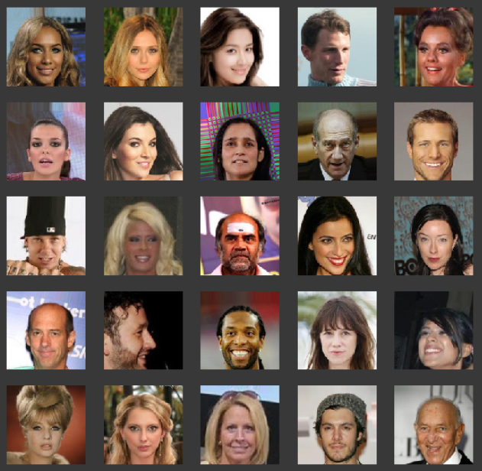
RESULTS
Input :
Output:
Demo Link
3/21/2024 Annual Review

